Slide 1
STUDENT
TIME
* Alina Kravchenko— chief editor
* Kateryna Turbar—designer
* Viktoria Zhuliskaya—journalist
* Kate Salinskay— journalist
* Snezhana Bilichenko—journalist

Slide 2
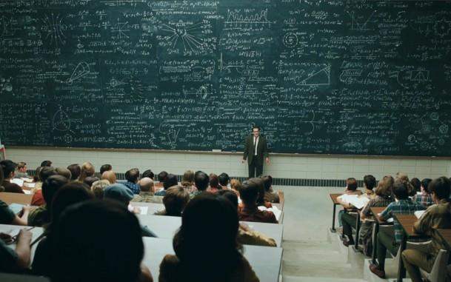
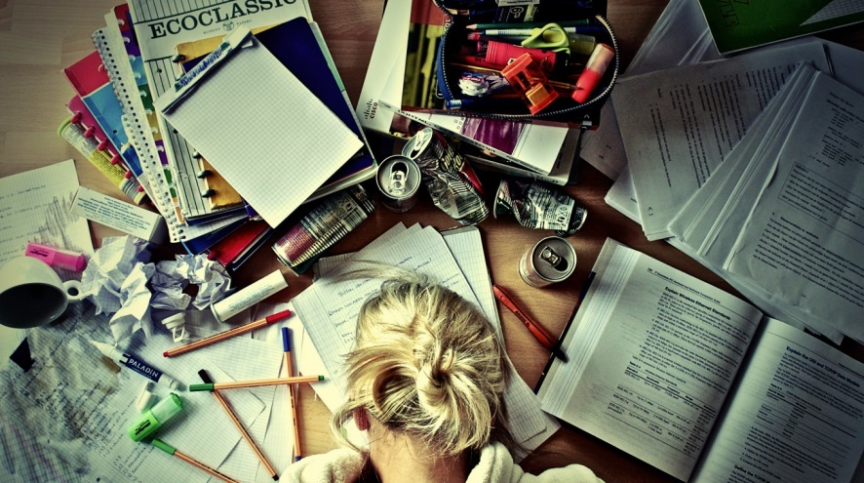
STUDENT
TIME
It is your time ..
The heart of Ukraine
“He tore the darkness” - story about man who could be called a hero.
Advise for you; how to be a successful student
National Mining University — Compliance with the Time
Department of Foreign Languages ‌‌
Horoscope for 2014 year
Page of student humor

